Slide 1

Customer Shopping Behavior Analysis
Analyzing 3,900 purchases to uncover insights into spending patterns, customer segments, and product preferences that drive strategic business decisions.

Slide 2
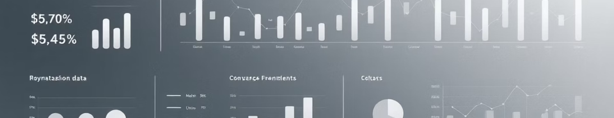
Dataset Overview
3,900
18
$59.76
3.75
Total Purchases
Data Points
Average Purchase
Average Rating
Comprehensive transaction records analyzed
Customer demographics, purchase details, and behavior metrics
Mean transaction value across all categories
Customer satisfaction score out of 5

Slide 3

Data Preparation & Cleaning
Python Analysis Steps
Loaded dataset using pandas
Explored structure with df.info() and .describe()
Imputed 37 missing Review Rating values using median by category
Standardized columns to snake_case
Created age_group and purchase_frequency_days features
Dropped redundant promo_code_used column
Connected to PostgreSQL database for advanced SQL analysis and loaded cleaned data for business intelligence queries.

Slide 4

Revenue Insights by Gender
Male Customers
$157,890 total revenue
Represent 67.74% of total revenue and males are 68% of customer base
Female Customers
$75,191 total revenue
32.26% of revenue from 32% of customer base, showing balanced spending patterns

Slide 5






Customer Segmentation Analysis
Returning
701 customers (18%)
Loyal Customers
Moderate engagement with growth potential
3,116 customers (80%)
Frequent purchasers driving consistent revenue
New Customers
83 customers (2%)
Fresh acquisition opportunities
Customer loyalty analysis reveals strong retention with 80% classified as loyal buyers, presenting opportunities to convert returning customers into the loyal segment.

Slide 6



Subscription Impact
73%
Non-Subscribers
2,847 customers generating $170,436
27%
Subscribers
1,053 customers generating $62,645
Subscribers spend $59.49 on average vs. $59.87 for non-subscribers, showing minimal difference. However, repeat buyers (>5 purchases) show 958 subscribers vs. 2,518 non-subscribers.

Slide 7

Product Performance Leaders
1
2
3
Gloves
Sandals
Boots
Highest average rating: 3.86/5
Second highest rating: 3.84/5
Strong performance: 3.82/5
4
5
Hat
Skirt
Consistent quality: 3.80/5
Top five rating: 3.78/5

Slide 8
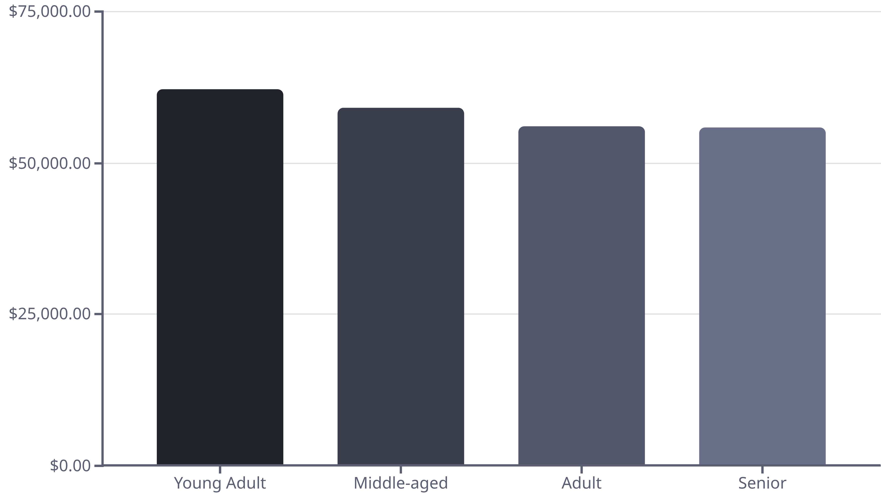
Revenue by Age Demographics
Young adults lead revenue generation at $62,143, followed closely by middle-aged customers at $59,197. Distribution is relatively balanced across age groups, suggesting broad market appeal.

Slide 9




Power BI Dashboard Highlights
Category Performance
Shipping Analysis
Discount Patterns
Clothing leads with highest revenue and sales volume across all product categories
Express shipping users spend $60.48 average vs. $58.46 for standard shipping
839 customers used discounts but still spent above average, indicating price-insensitive segments

Slide 10





Strategic Recommendations
Boost Subscriptions
Promote exclusive benefits to convert the 73% non-subscriber base into recurring revenue streams
Loyalty Programs
Reward repeat buyers to move 701 returning customers into the loyal segment of 3,116
Optimize Discounts
Balance promotional sales with margin control—839 high spenders used discounts unnecessarily
Targeted Marketing
Focus on young adults ($62K revenue) and express shipping users who demonstrate higher spending

